Slide 1
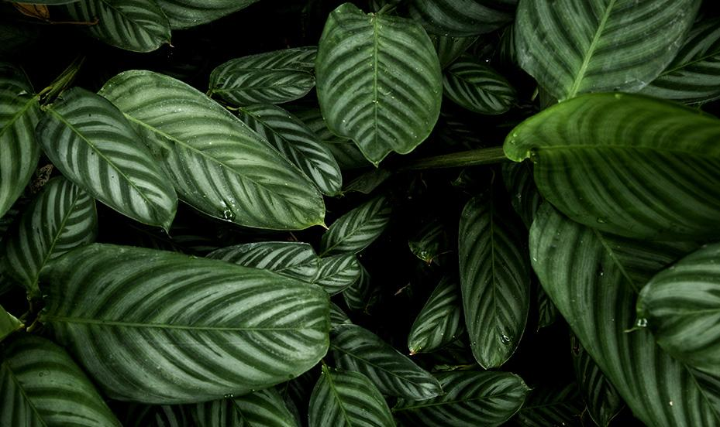
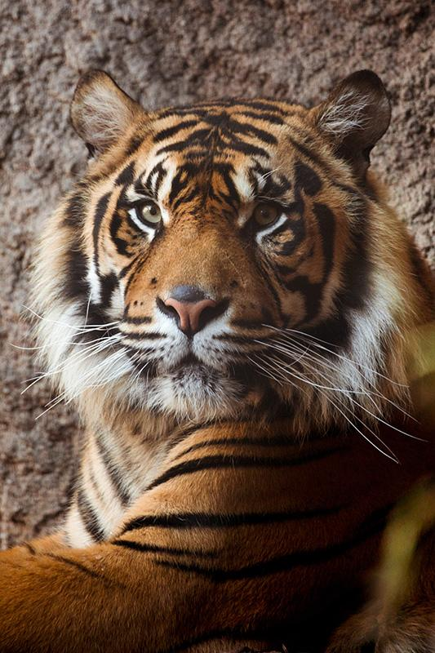
THE FUTURE OF BRAZILIAN TROPICAL BIOMES

Slide 2
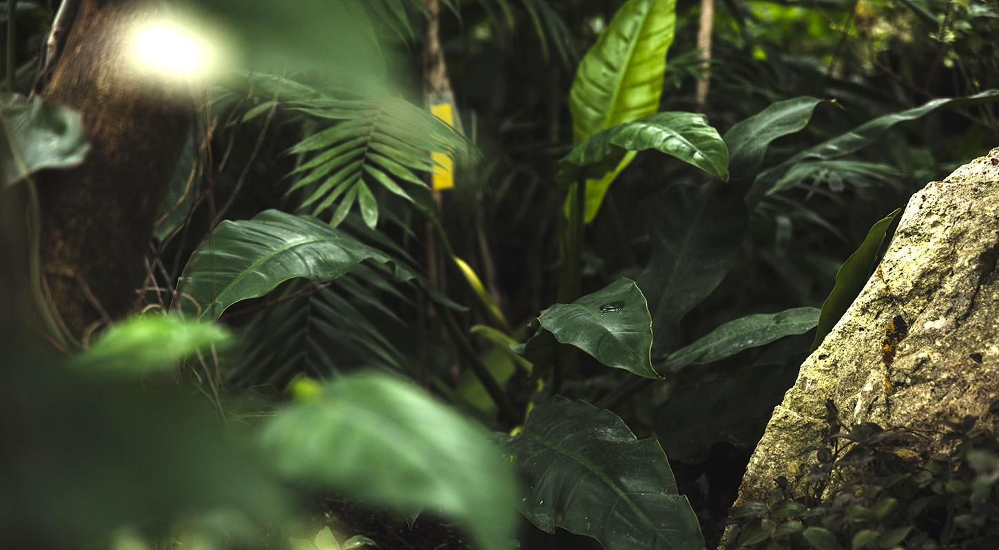
01
BIOMES

Slide 3
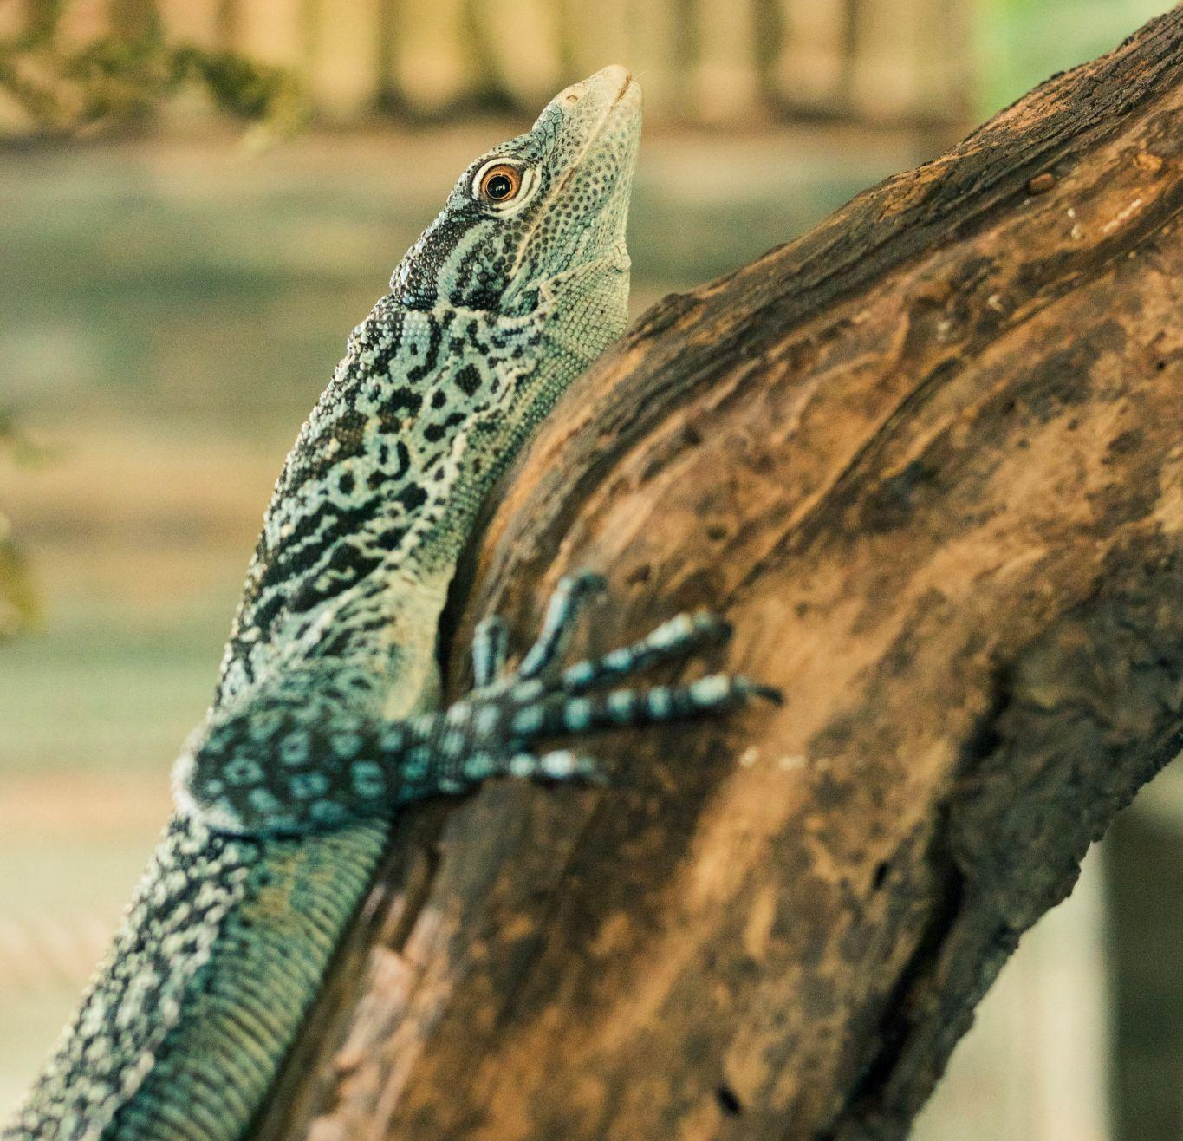
HERE IS THE SLIDE TITLE!
The Amazon is home to over 30 million people, including almost 3 million indigenous people.
4/ Despite its importance, every minute an area of Amazon Rainforest roughly equivalent to 5 football pitches is cut down. So the Amazon is reaching an irreversible tipping point. Deforestation in the first half of 2022 was 3 times higher than in the first half of 2017. But there is hope. This highly valuable landscape, which has never received the same attention as its more celebrated neighbor, the Amazon, is being destroyed at a frighteningly fast pace.
Biodiversity (The largest amount of living organisms in the world e.g. we found half of the world's species of plants, animals and microorganisms approximat 10 million different species )
Photosynthesis produce oxygen for the world (20% of the oxygen of the world is coming from the Amazon)

Slide 4
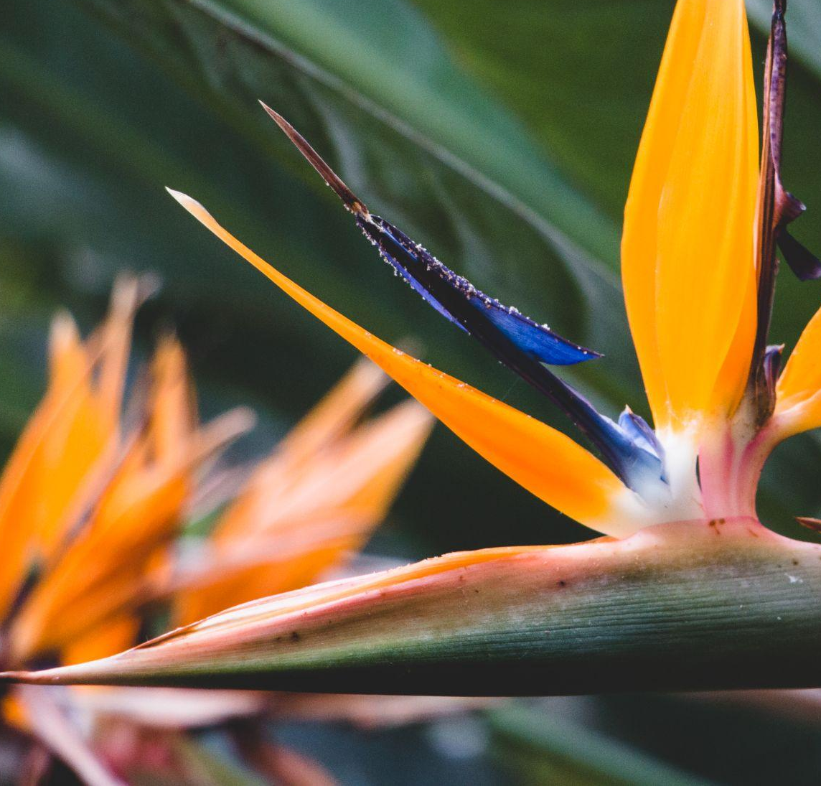
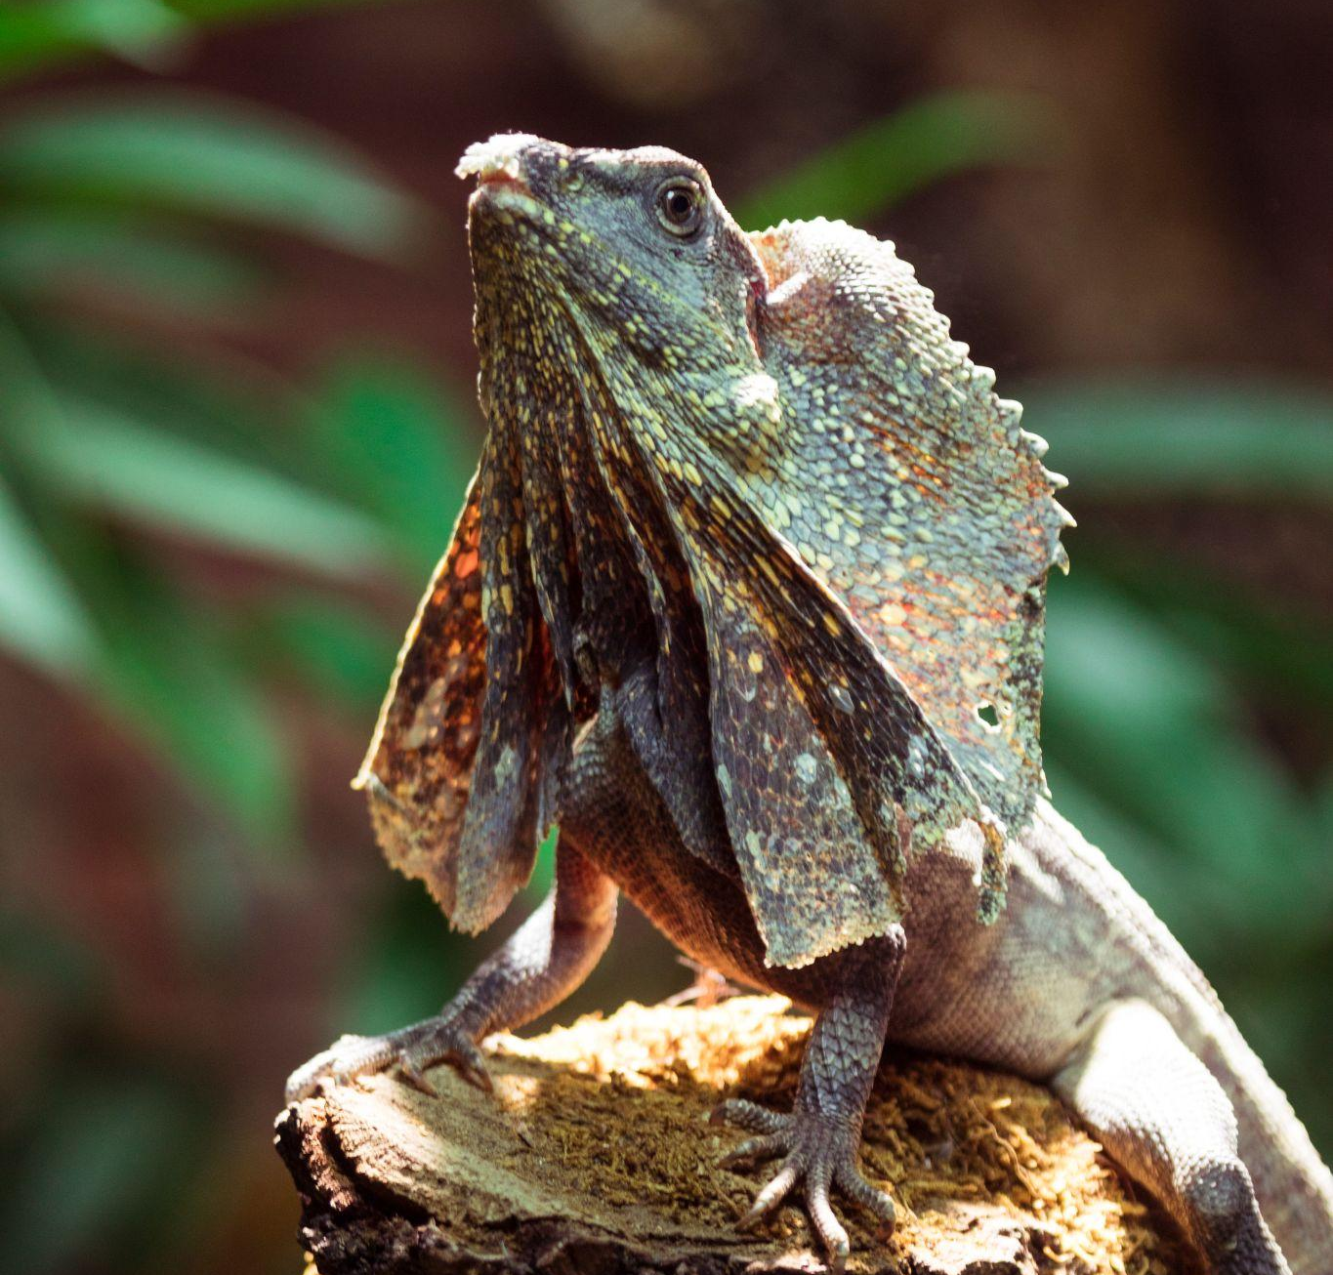
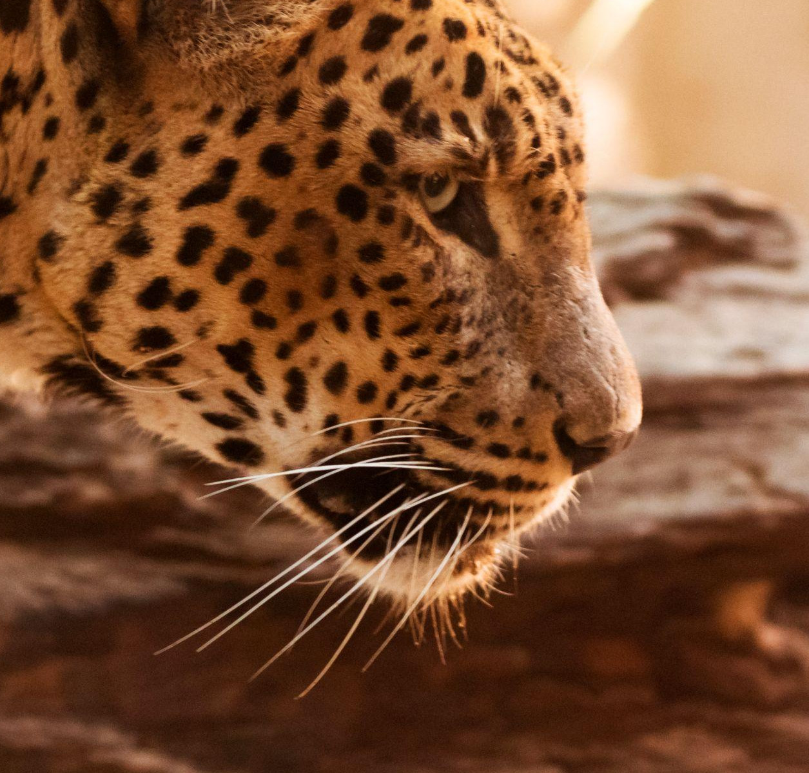
AMAZON VS CERRADO
AMAZON
CERRADO
Tropical Biome which only takes up 3.5% of the Earth’s land yet it is home to one in ten (10%) of all the known species in the world.
Over 500,000 people in approx. 200 different tribes live traditional lives.
Second largest vegetation type in Brazil – Tropical & Sub-tropical.
Size of England, France, Germany, Italy & Spain combined.
Only 20% of the original vegetation remains intact; less than 3% of the area is currently protected by law.
VS
6.7 million km² : 2 million km²
: 21% of Brazil
10% Earth’s Species : 5% of Earth’s Species
1 in 10 Species : 1 in 20 species

Slide 5
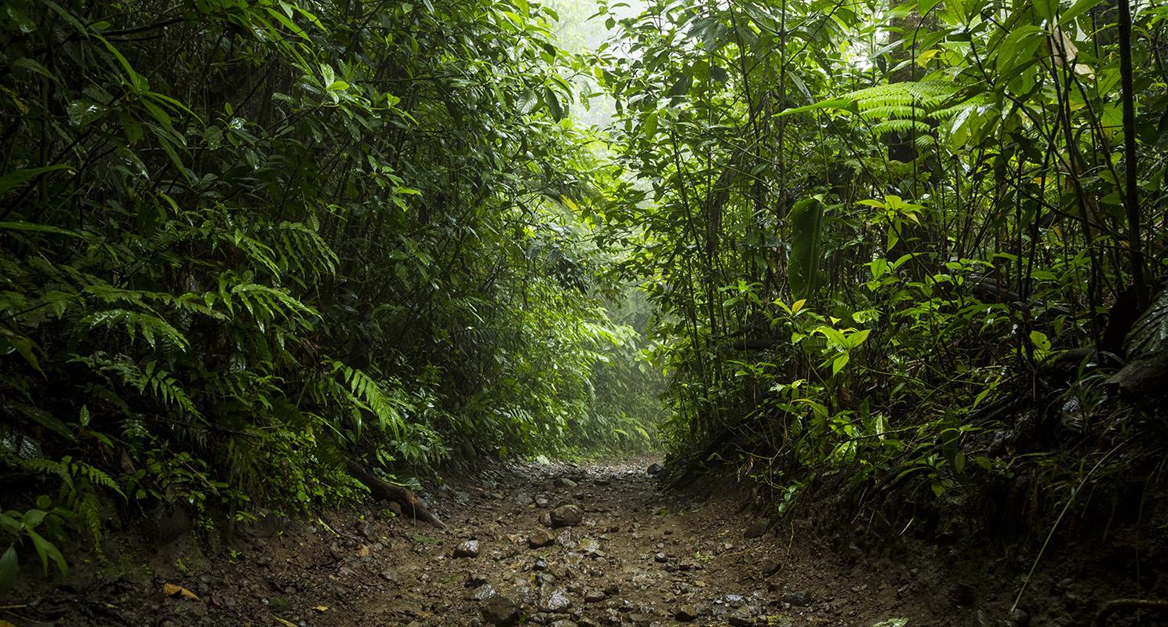
BENEFITS FOR EVERYONE
4%
25%
70%
DAY 1
DAY 2
DAY 3
Mercury is the closest
planet to the Sun
Jupiter is the biggest
planet of them all
Despite being red,
Mars is a cold place

Slide 6
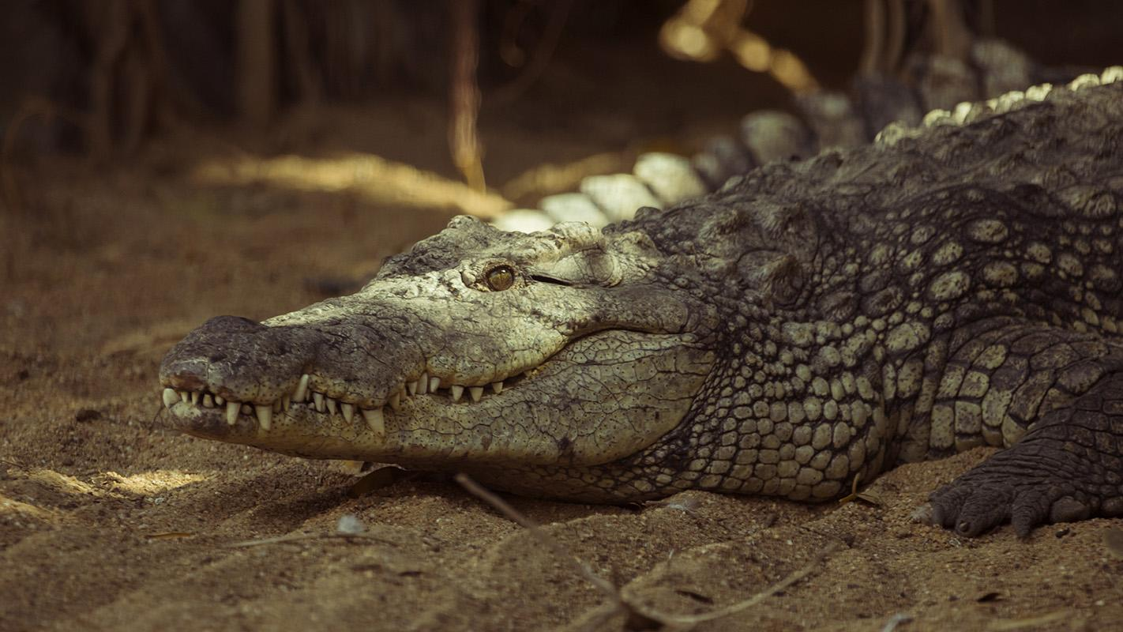
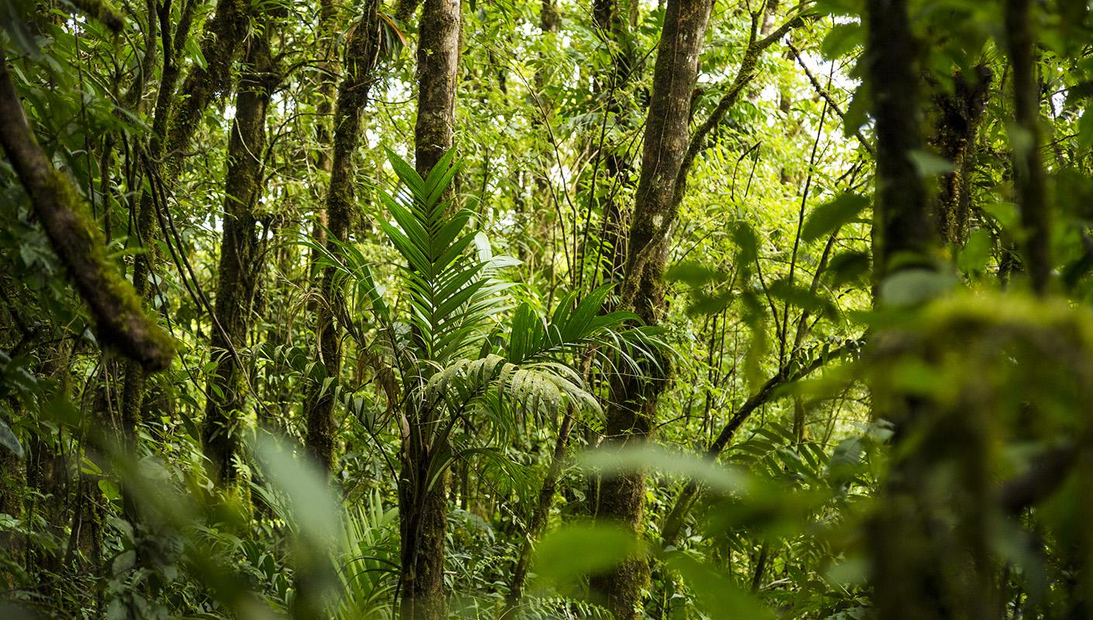
BENEFITS
HEALTH
CLIMATE CHANGE
Despite being red, Mars is a
cold place. It’s full of
iron oxide dust
Currently, 121 prescription drugs (medicine) currently sold worldwide come from plant-derived sources.
70% of the plants identified as having anti-cancer characteristics by the US National Cancer Institute are found only in the tropical rainforest
e.g. Periwinkle Plant is in the most powerful cancer fighting medicines.
OXYGEN
20% of the world’s oxygen is produced by the trees of the Amazon.

Slide 7
PUT IN SLIDE ABOVE IF MOVE SLIDE ABOVE
INCREASED GREENHOUSE GAS EMISSIONS
Forests are carbon sinks and, therefore, help to mitigate the emission of carbon dioxide and other greenhouse gases. Tropical forests alone hold more than 228 to 247 gigatons of carbon, which is more than seven times the amount emitted each year by human activities.
But when forests are cut, burned or otherwise removed they emit carbon instead of absorb carbon. Deforestation and forest degradation are responsible for around 15% of all greenhouse gas emissions. These greenhouse gas emissions contribute to rising temperatures, changes in patterns of weather and water, and an increased frequency of extreme weather events. For example, in Sumatra, rainforests on deep peatlands are being cleared, drained and converted to pulp plantations, contributing to Indonesia’s high greenhouse gas emissions. Changes in climate can affect forest-dwelling creatures by altering their habitats and decreasing availability of food and water. Some will be able to adapt by moving to higher elevations or latitudes, but species losses may occur.
DISRUPTION OF WATER CYCLES
Trees play a key role in the local water cycle by helping to keep a balance between the water on land and water in the atmosphere. But when deforestation or degradation occurs, that balance can be thrown off, resulting in changes in precipitation and river flow.
INCREASED SOIL EROSION
Soil erosion in Central African Republic
Soil erosion in Africa.
Without trees to anchor fertile soil, erosion can occur and sweep the land into rivers. The agricultural plants that often replace the trees cannot hold onto the soil. Many of these plants—such as coffee, cotton, palm oil, soybean and wheat—can actually exacerbate soil erosion. Scientists have estimated that a third of the world’s arable land has been lost through soil erosion and other types of degradation since 1960. And as fertile soil washes away, agricultural producers move on, clearing more forest and continuing the cycle of soil loss.
DISRUPTED LIVELIHOODS
1.25 billion people around the world rely on forests for shelter, livelihoods, water, fuel, and food security. And 750 million people (approximately one-fifth of total rural population) live in forests. This includes 60 million indigenous people. But deforestation disrupts the lives of these people, sometimes with devastating consequences. In the Greater Mekong in Southeast Asia, where land tenure systems are weak, deforestation has contributed to social conflict and migration. In Brazil, poor people have been lured from their villages to remote soy plantations where they may be abused and forced, at gunpoint, to work under inhumane conditions. More than three-quarters of the world’s documented land-based species can be found in forests. When species lose their forest homes, they are often unable to subsist in the small fragments of forested land left behind. They become more accessible to hunters and poachers, their numbers begin to dwindle and some eventually go extinct. Even localized deforestation can result in extinctions as many unique species exist in small isolated geographic locations in the world.

Slide 8
CERRADO DEFORESTATION
927,109,872
256,102
Is the total deforestation in km² since 2001
Predicted on the next two years/in Cerrado in 2022

Slide 9
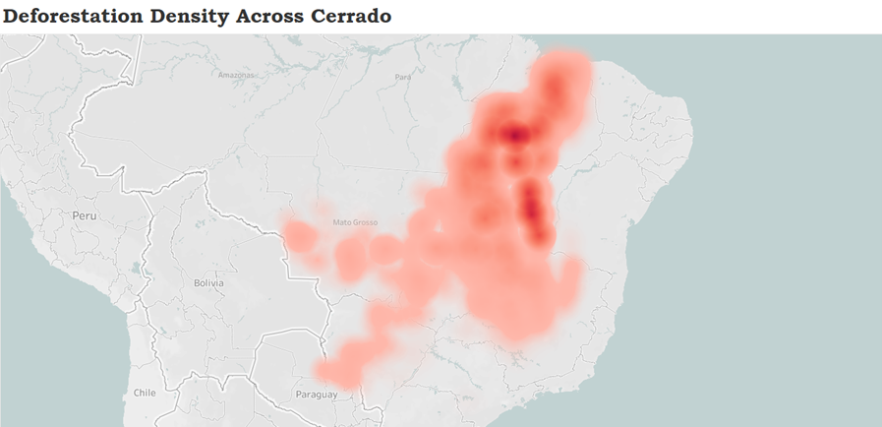
2022
Notes:
Which has lead to the

Slide 10
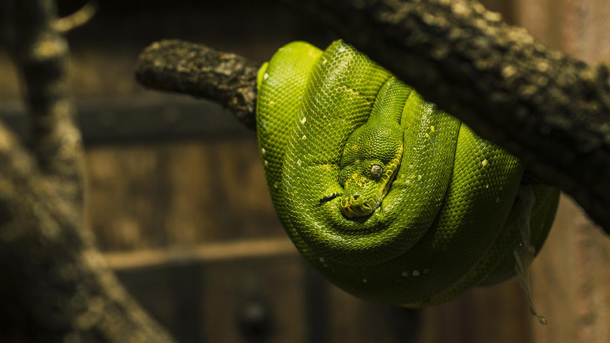
CO2

Slide 11
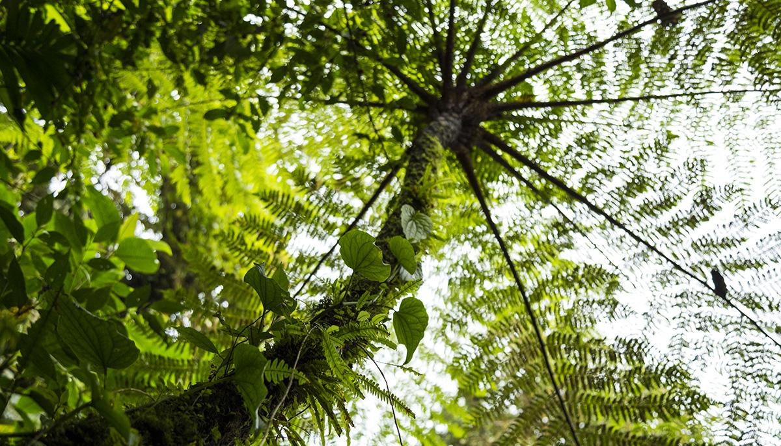
180,524
Big numbers catch your audience’s attention

Slide 12
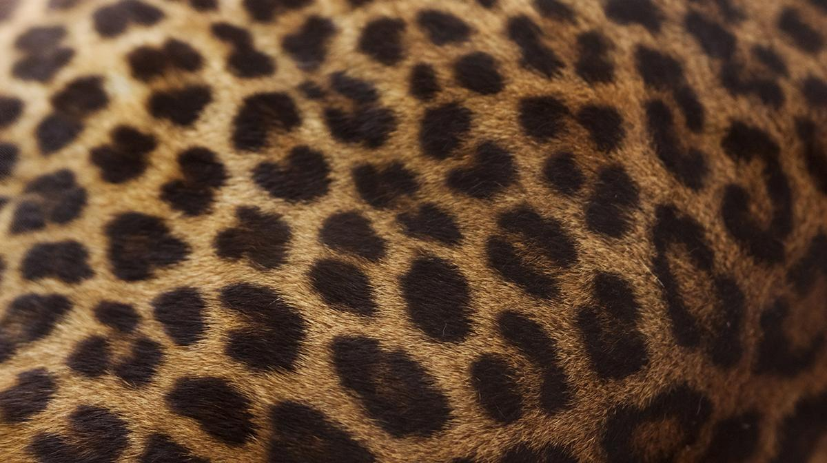
02
FUTURE
Predicting the future

Slide 13
EXPORTS
SATURN
Despite being red, Mars is a cold place
Saturn was named after a Roman god
JUPITER
Venus is the second planet from the Sun
Jupiter is the biggest planet of them all
MERCURY
NEPTUNE
It's the smallest planet in the Solar System
Neptune is very far away from the Sun

Slide 14
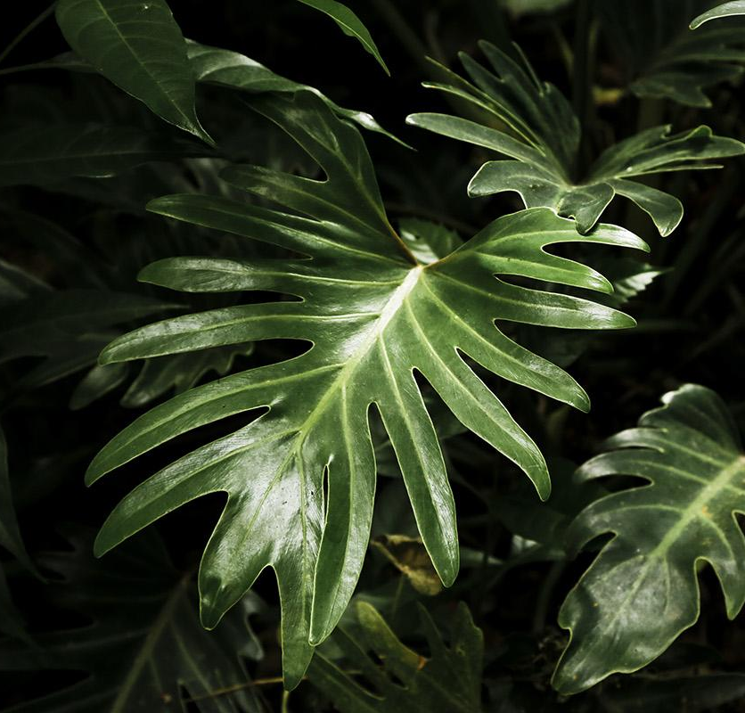
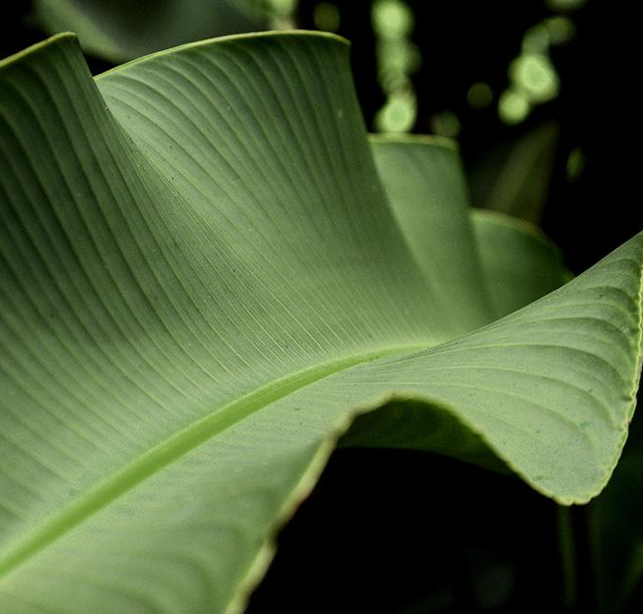
DIVIDE YOUR CONTENT
OXYGEN
HEALTH

Slide 15
EXPORTS
JUPITER
MARS
It’s the biggest planet of them all
Despite being red, Mars is a cold place
VENUS
MERCURY
It has a beautiful name, but it’s hot
It’s the closest planet to the Sun

Slide 16
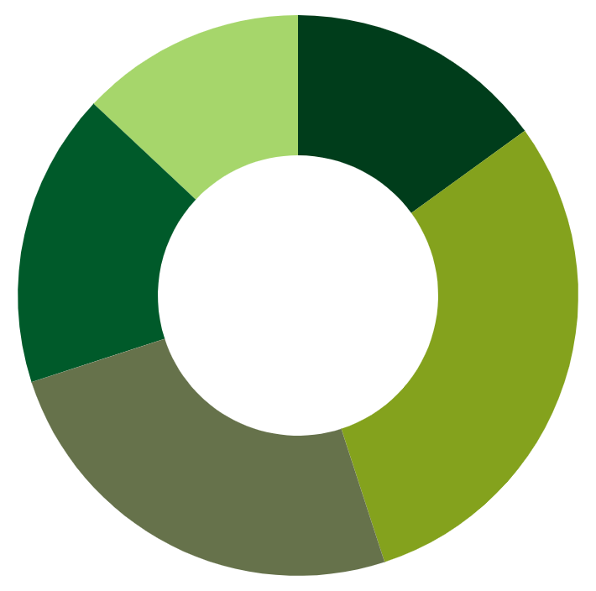
EXPORTS IF CAN GET %’S
NORTH
13%
15%
CENTER
EAST
WEST
17%
SOUTH
30%
To modify this graph, click on it, follow the link, change the data and paste the resulting graph here
25%

Slide 17
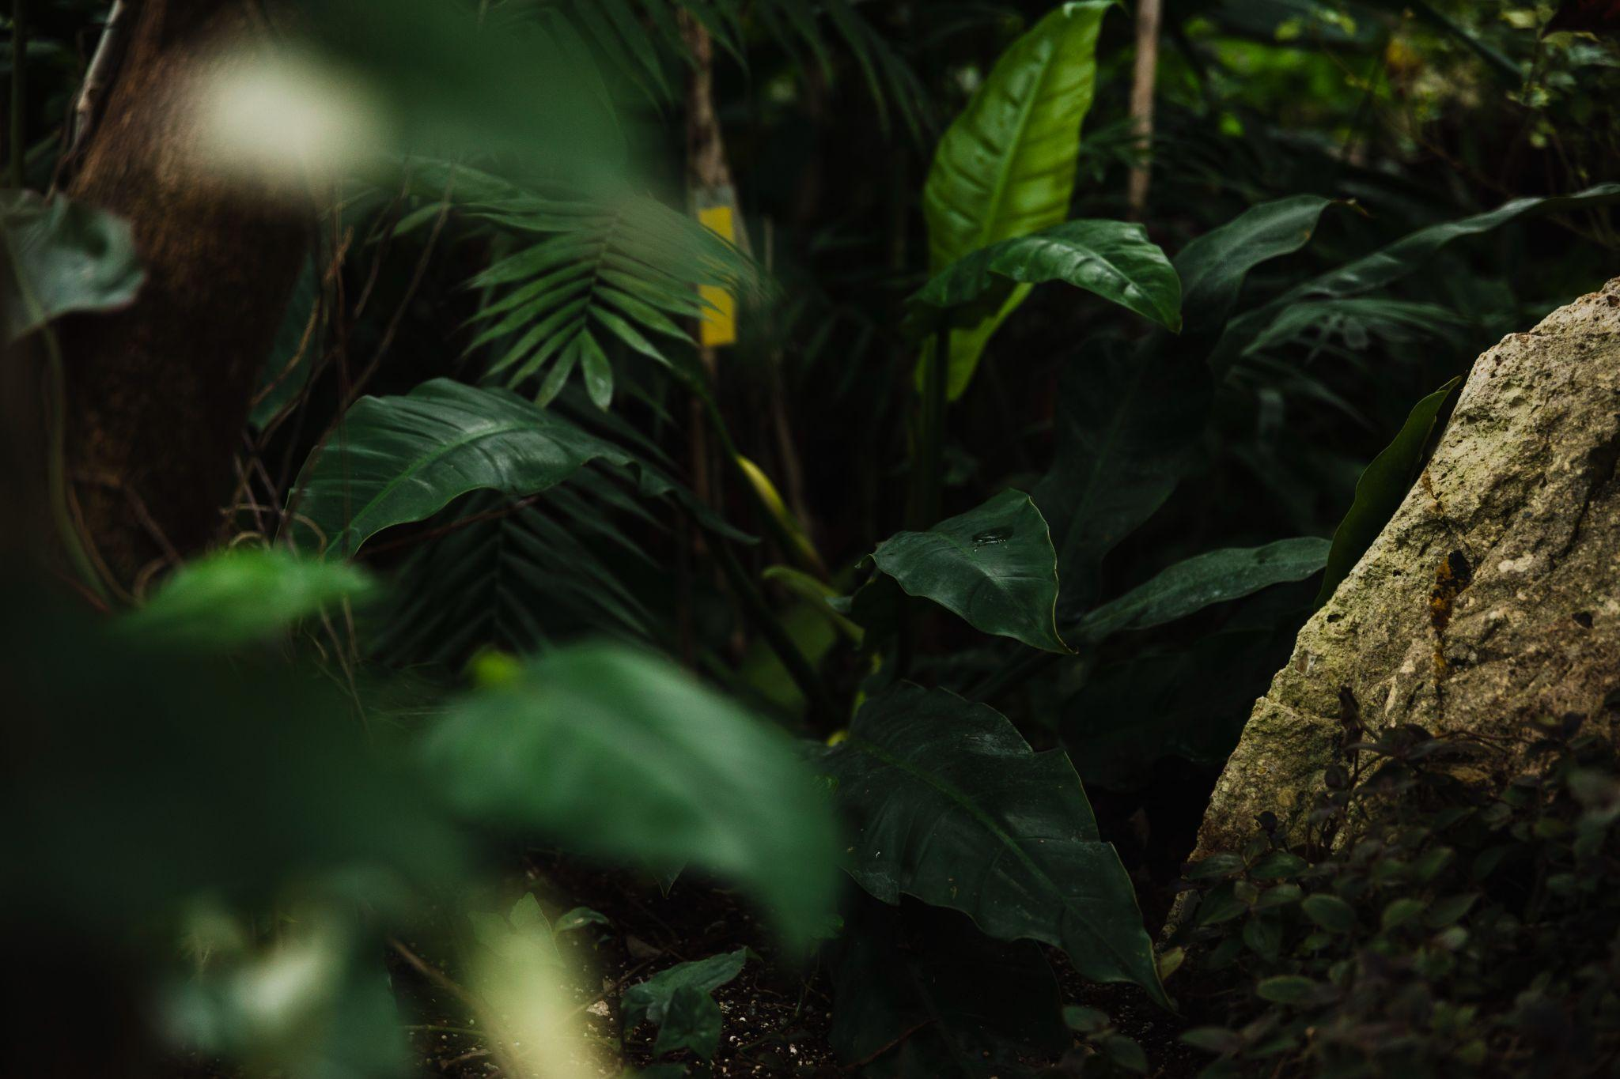
From 2024, the EU will require firms working in deforestation hotspots to certify that their goods have not harmed forests after a cutoff date of 31 December 2020.

Slide 18
EUROPEAN UNION
Law should have been discussed but was not due to Covid 19
A year before the law comes into place
2020
2023
2022
2024
In December the Law finally came into place
Previous law will come into place. Next time they re-discuss the law

Slide 19
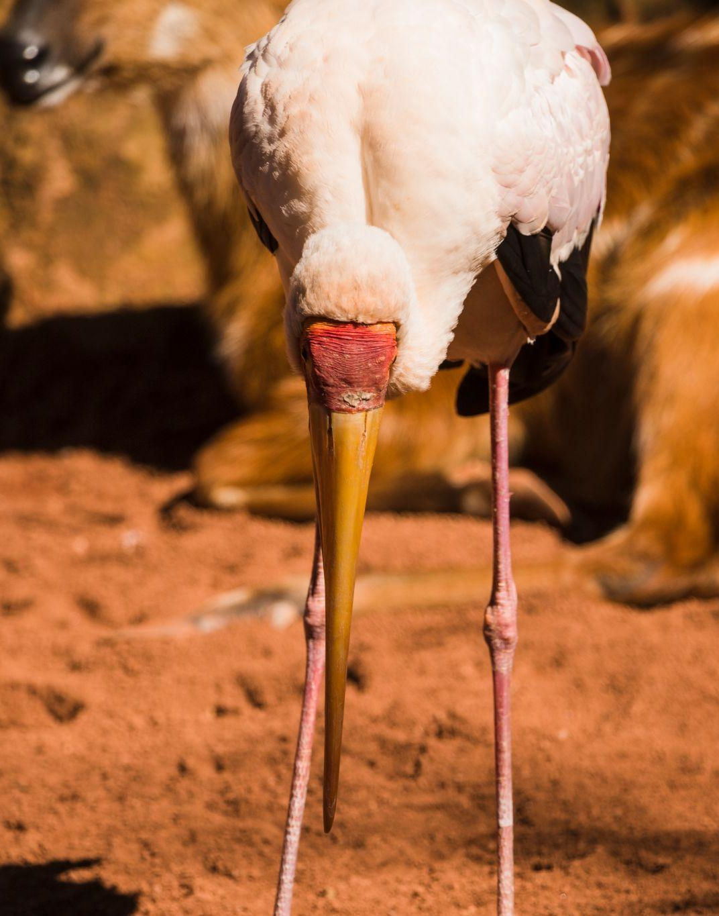
9h 55m 23s
333,000
38,000 km
PREDICTED
NOW
PREDICTED

Slide 20
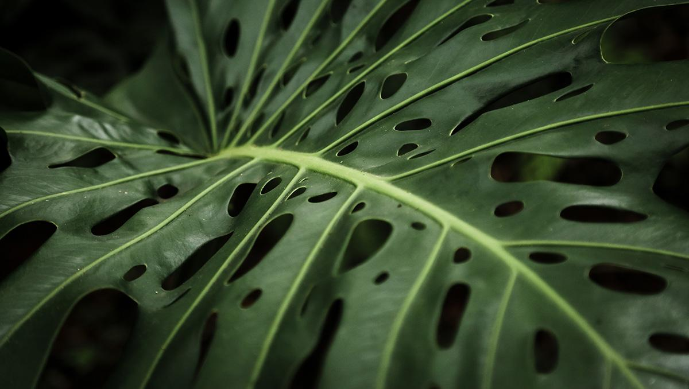
Without the Amazon & Cerrado, we lose the fight against climate change

Slide 21
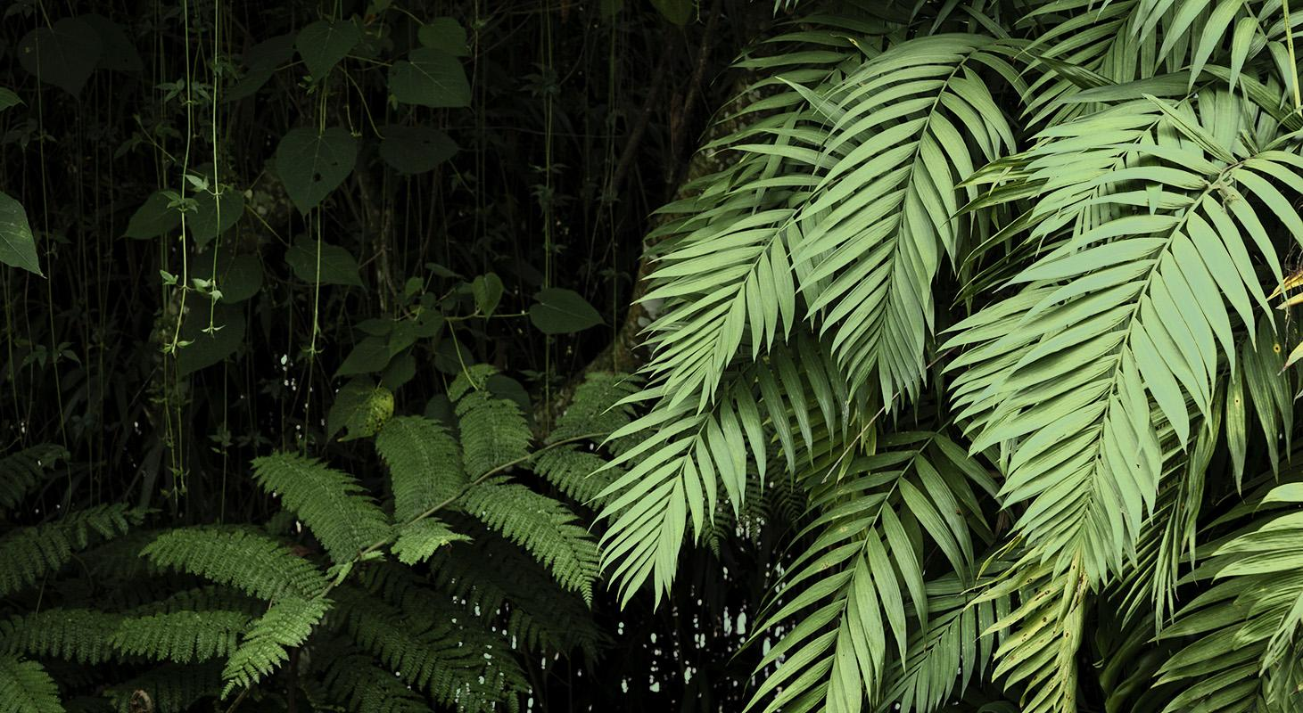
03
WHAT YOU CAN DO

Slide 22
Just 14 global agriculture companies have the power to save it by ending deforestation and conversion in their supply chains by 2025. If not, this critical habitat, water source, and carbon sink may be lost forever—putting a livable climate and global food security in jeopardy.

Slide 23
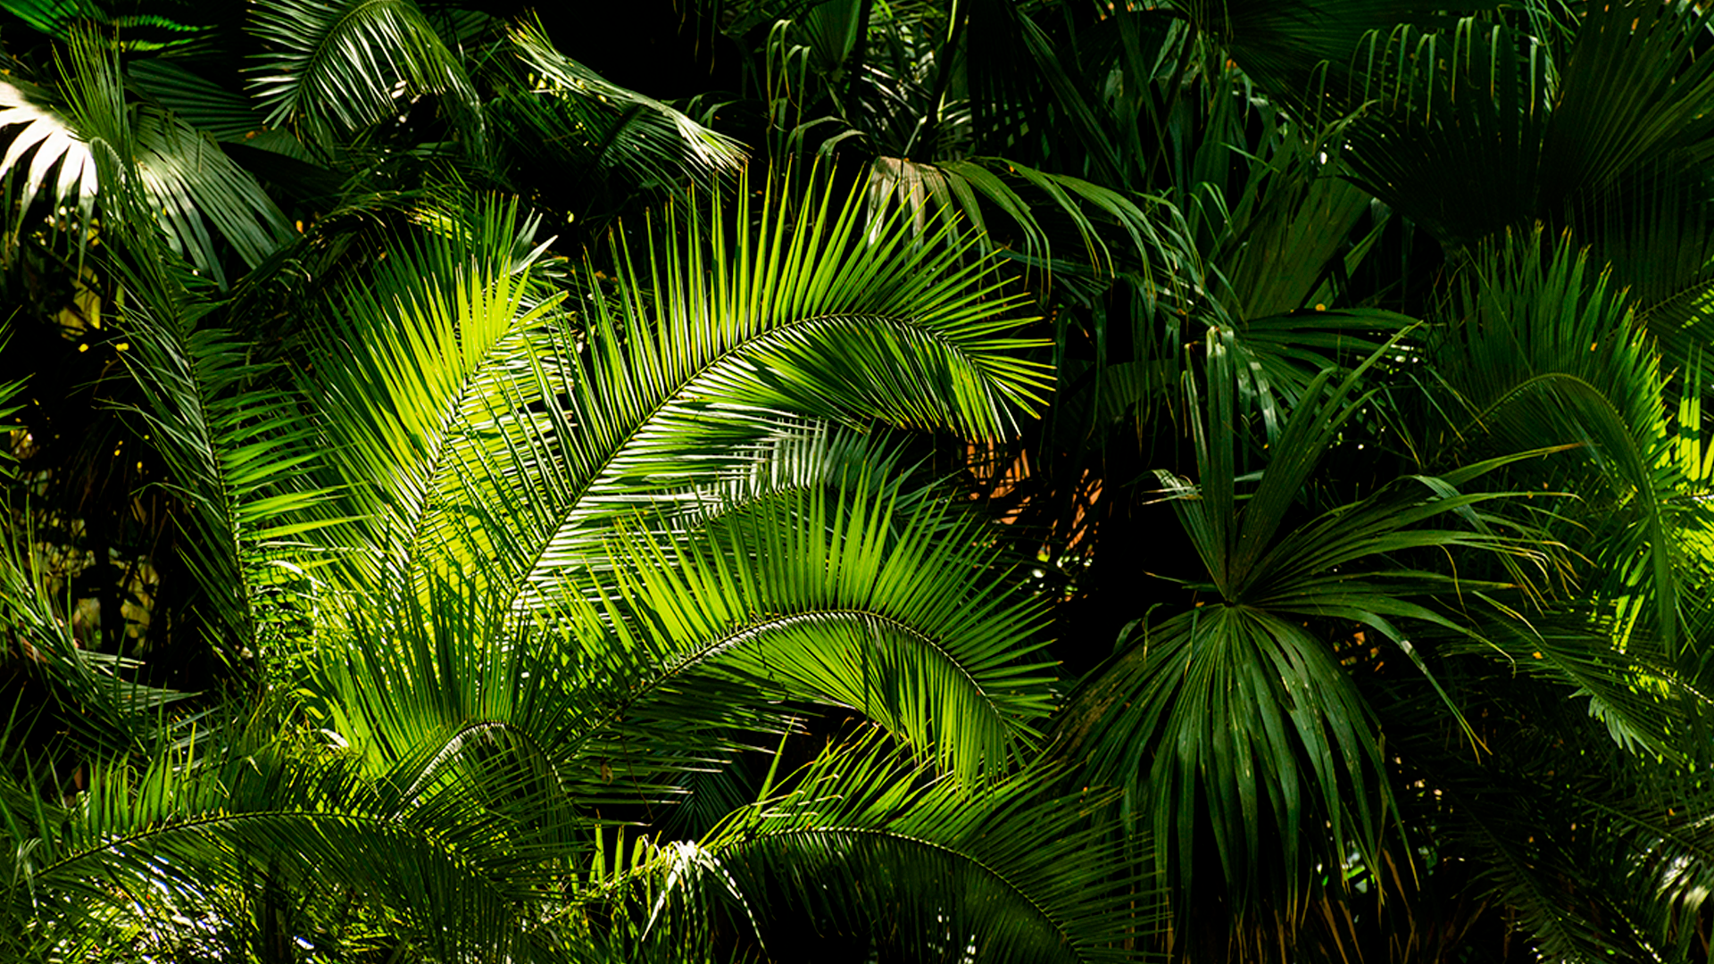

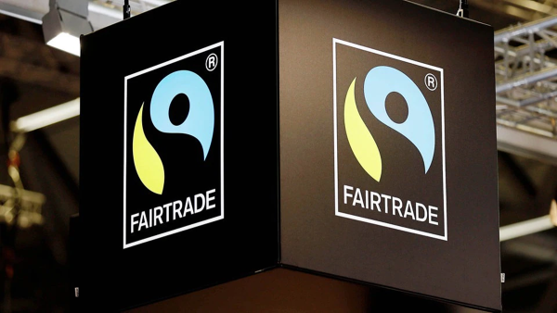
FAIR TRADE
A label of products which:
Ensures sustainability whilst monitoring deforestation and assessing environmental vulnerability

Slide 24
HOW TO GET INVOLVED
HOW TO GET INVOLVED
What can you do to support the embattled defenders of the Amazon, and indigenous rights more broadly?
Support the work of Amazon Watch – they are supporting local efforts in the Amazon, and providing in-depth research looking at the global supply chains and the corporations and financiers who are responsible.
Sign the petition to stop BlackRock—they are one of the largest investors in Brazil’s agribusiness industry, and their financial backing is key to the continued destruction of the Amazon.
Join local actions in your community—find a community event for the Global Day of Action for the Amazon on September 5th.
Support the Real Meals Campaign—we are calling on Aramark and the big cafeteria companies to drop their allegiance to Big Food and invest in a food system that is fair, humane, ecologically-responsible, and grounded in racial justice.
Support indigenous rights where you live—lookup whose lands you are on and educate yourselves on the issues faced by indigenous communities where you live.
Read up on other economic models—fair trade farmers, their cooperatives, and fair trade enterprises around the globe are just of a few of those who have been experimenting with community-based, solidarity economics over the past decades.
-WWF

Slide 25
FAIRTRADE & WORK RESOURCES
Fairtrade Shopping Lists & Re:sources
Online-Shoppingliste: Fairtrade Deutschland (fairtrade-deutschland.de)
Fair Trade Gifts & Accessories - The FAIR Trade Store
Produkt-Finder: Fairtrade Deutschland (fairtrade-deutschland.de)
Data Analysis Job Position Areas/Topics

Slide 26
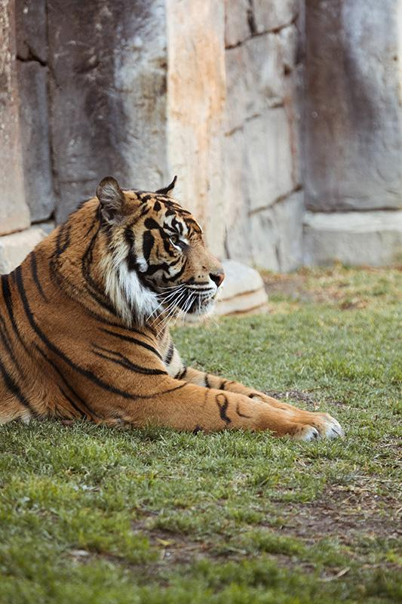
THANKS!
Do you have any questions, or would like to collaborate with us?
Contact us at:
nevin.poppy@outlook.com
References: WWF (Learn about the Amazon rainforest | WWF)

